Slide 1
Scripted Model Development
Jake Knight
Hydrologist
USGS Arizona Water Science Center

Slide 2
Introductions
Who am I?
Who are you?
What are we doing here?

Slide 3
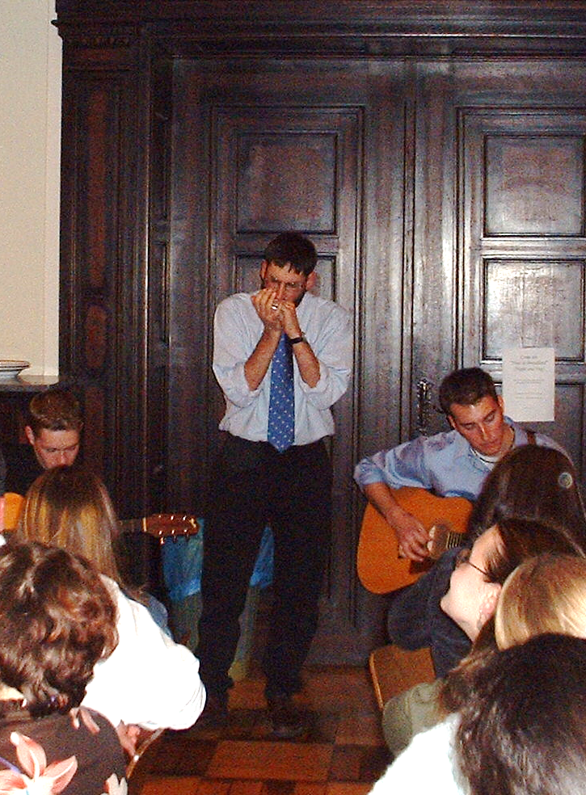
All about me (20yrs ago)
Miami Undergrad 2001-2005
Political science
Pre-med
Electives!
Geology seminar, German 101, Jazz orchestra
Somehow led to:
MUDEC study abroad semester in Luxemburg
Europe and the Environment, taught by….
Which led to:
HYDROLOGY!

Slide 4

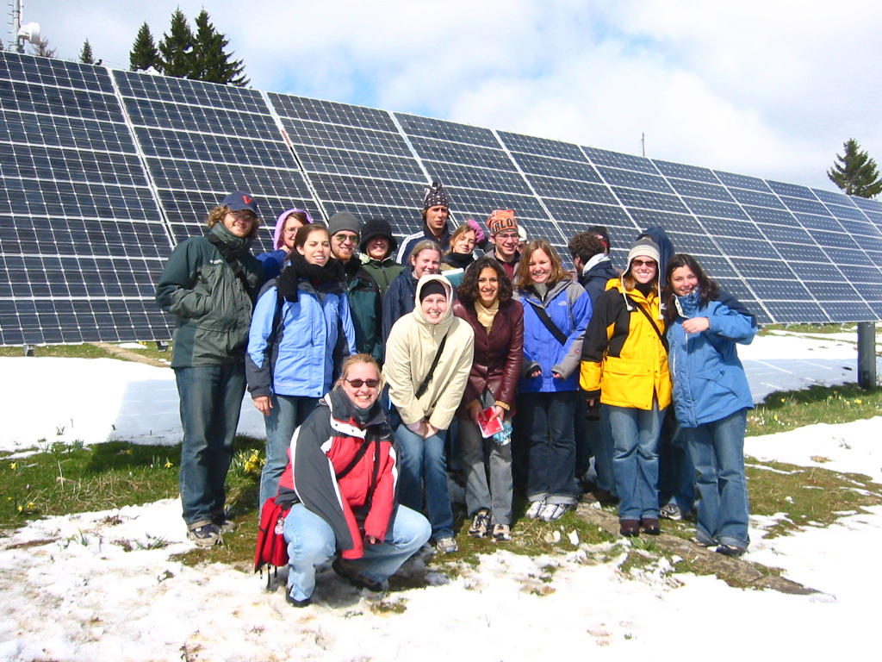
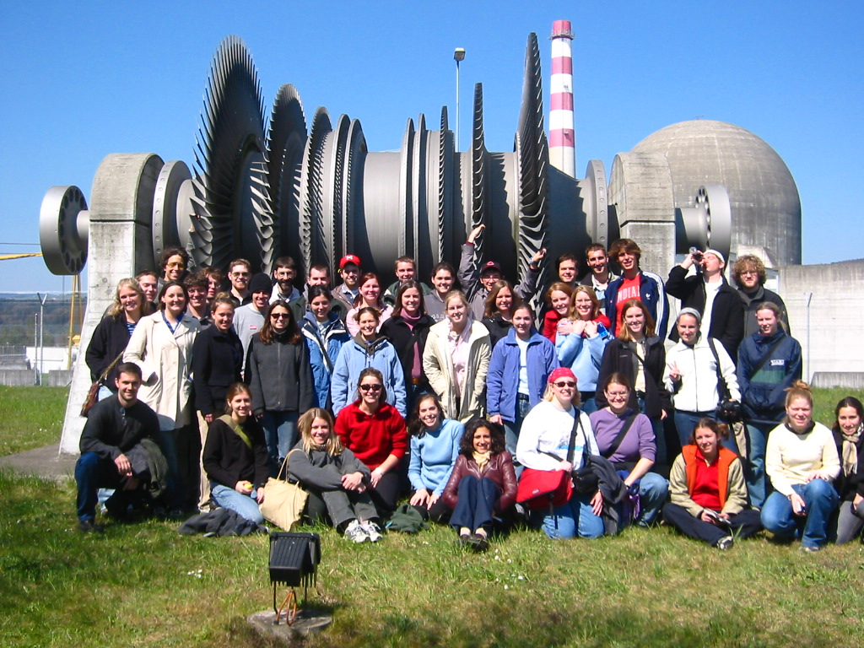
All about me (20yrs ago)
Environmental Science! HYDROLOGY!

Slide 5
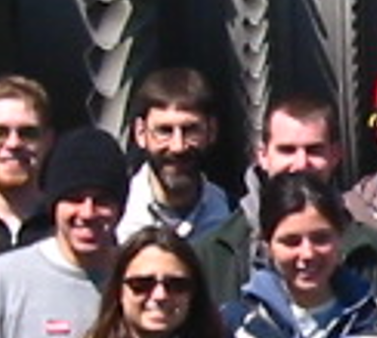

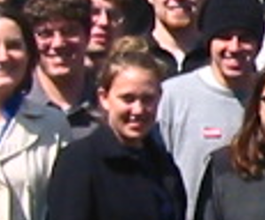

Slide 7
All about YOU
What’s your major, minor, thesis topic?
Any interest in Environmental System modeling?
Any experience writing/using code?
Care to share something about yourself?

Slide 8
Water we doing here
Interactive(ish) presentations that you can download and use later on
Ideally, we would run them together, but too many IT pitfalls for 2 hr session
Scripts are recipes, start simple and build from there
Introduction to scripted-development model workflows
Python + FloPy for MODFLOW models
Load, build, run, investigate, plot
Python + PyEmu for PEST++ deployments
Define parameters and observations, evaluate and upgrade ensembles of models
Case study on opportunities and benefits of a scripted approach
Anything else you want to discuss!
Career advice? Let me tell you about USGS!

